Slide 1
Suitability & Career Planning

Slide 2
Job vs. Career
Don’t rush to enroll someone in WIOA because they are eligible (suitability 101).
Set Realistic & Achievable Goals
Formulate a Plan to Reach Goals

Slide 3
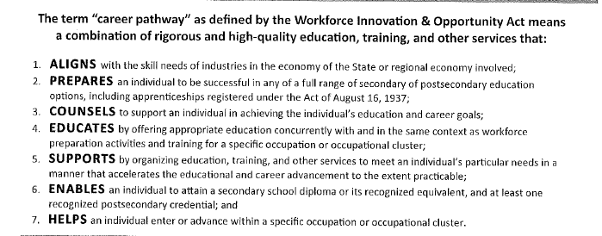
Career Pathways

Slide 4
Suitability (Appropriateness)
The selection of eligible applicants that is determined through the assessed ability and the perceived personal commitment of the customer to attend activities, to successfully complete these activities and to acquire employment and/or post-secondary education.
Based on assessments performed by the career advisor.
There are different types of suitability:
Suitability for enrollment.
Suitability for training or specific services.

Slide 5
Assessment
The evaluation or estimation of the nature, quality, or ability of someone or something.
Synonyms: evaluation, judgement, gauging, rating, estimation, appraisal, opinion, analysis.
Tools to help determine suitability.
Career advisor’s advising system for customers.
Can be oral or written.
Suitability screening starts with the first conversation!

Slide 6
Oral Assessment
Valuable information on suitability can be obtained through conversation with the customer.
Likes and dislikes, interests, values, goals, etc.

Slide 7
Written Assessment
TABE, Traitify, My Next Move, CRC, etc.. (Aptitudes, Skills, Interest & Goals)
Results from written assessments should be listed on the IEP.
The ultimate goal: EMPLOYMENT!
“Thought” and an evaluation of written assessment outcomes must be performed for effective suitability screening.

Slide 8
Key Items to Consider:
Are immediate goals too ambitious for their current situation?
What is the customer's history of completing goals?
If barriers are present what are they and how difficult are they to overcome?
How many agencies will be needed to provide interventions?
Will WIOA and other agencies make a significant difference in the customer's ability to attain credentials, employment and/or post-secondary advancement?
Is the customer able to work?
What can WIOA do for this customers?
Can the customer complete goals and complete the program successfully?

Slide 9
Disqualifications
Individual requires extensive support beyond the ability of what WIOA provides.
Need to resolve problems or personal barriers.
Individual's training needs are served more appropriately by another agency.
The training desired cannot be met by WIOA funding.
Life is an immediate crisis and/or individual cannot participate in WIOA activities at this time.

Slide 10
Disqualifications
Cannot allocate sufficient time for the required commitment to the program.
Consistent failure to show for scheduled appointment.
Require or insist on services sooner than WIOA can provide them.
Admitted active substance abusers who show no interest in rehabilitation to overcome dependency.
Any time a person is determined not suitable for WIOA, it should be properly documented in case notes along with referrals to other services/agencies and any other recommendations.

Slide 11
Bad Practices
This person is eligible. I need numbers/enrollments so I’m going to enrolled him/her in the program.
This person is eligible. I’m going to enroll him/her and I’ll decide what to do with them later. (Basic Career Services)
I don’t know how to overcome all these barriers this person has, but it’s an enrollment.
Career goal does not match jobs available in the area.
Barriers not addressed for enrolled participants.
No documentation of career guidance and planning (overcoming barriers) in case notes.

Slide 12
Bad Practices
No WEX enrollments. This is a great opportunity for individuals with no work experience in their career field to gain valuable work experience and possible WEX to OJT.
Can’t or won’t tell the individual “NO”.
I know the person was not suitable, but I was told to put them in.
Underserved populations, no enrollments in approved training occupations. WEX component not used.
Lack of referrals. Most referrals are the hardest of the hard to placed.

Slide 13
Questions/Comments

